Slide 1
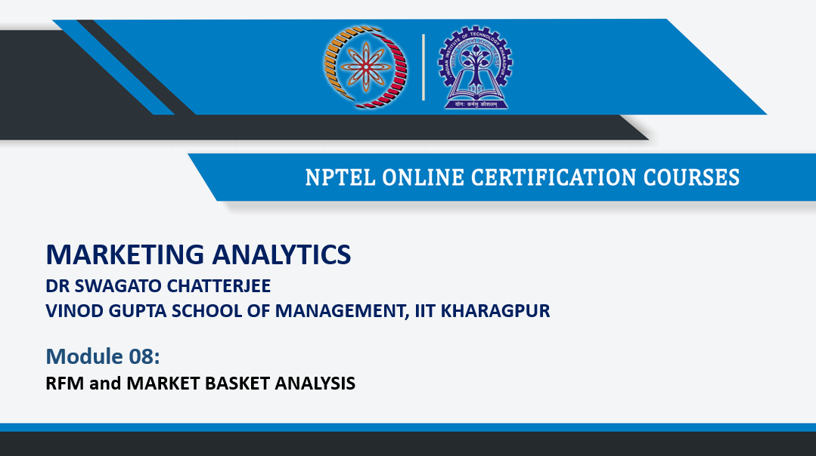

Slide 2
Contents
Introduction
What’s RFM?
RFM Analysis
Procedure for RFM analysis
RFM for measuring performance of salespersons
More insights on RFM
Alternative RFM measures

Slide 3
Introduction
Suppose, you are a math’s teacher of class 10 and you want to evaluate performance of the students in the semester test which was taken recently to evaluate whether they are ready for final exam or not? Where are they weak? How can we improve their performance?
So, while selection of a good students you will look for
Whether students has attended the classes recently. (Recency)
Whether students has solved problems of homework. (Frequency)
Whether students put enough efforts to learn about the subject. (Monetary)

Slide 4
Introduction
So, to evaluate this problem you will simply do a segmentation of a students and then by using data as well as intuition you will evaluate good as well as bad students.
Similarly,
To strive in the present customer driven economy, proper customer insights are necessary to gain. Then only by improving user experience, establishing a long term relationship between customer and company is possible.
In order to survive with tough competition, development of innovative marketing plans for a customers and serve them to the height of desired satisfaction is must.
RFM is a simple and intuitive technique for segmentation of customers and has been used by marketers for decades.
Let’s see what’s RFM.

Slide 5
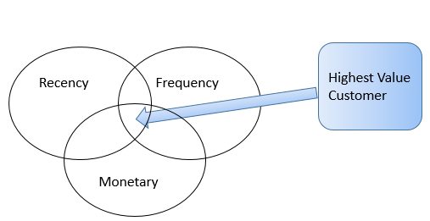
What’s RFM?
RFM is a marketing technique used for analyzing customer value.
RFM stands for three dimensions
Recency : When did customer make their last purchase?
Frequency: How often does customer make their purchase?
Monetary: How much Money does the customer spend?

Slide 6
Now What’s RFM Analysis?
RFM analysis helps companies to take decisions on promotions and offers for selected customer base.
It’s a method which helps companies to find ways to improve customer spending.
It’s a useful technique to track lost customer base and give them incentives to purchase company products.
RFM analysis helps companies to track the customer base and build a relationship that can increase sales and productivity.
It’s also useful to identify and track minimal losses.

Slide 7
Procedure for RFM analysis
Divide customer base into 10 equal groups (10% each)
Give Recency, Frequency and Monetary scores on the scale of 0 to 9.
Score ‘0’ Means least favoured, whereas ‘9’ means most favoured
Most recent customer will come into R score 0. second most recent customer will get R score 1 and so on.
Continue scoring until all groups receive the score.
Priorities of this analysis will be
1. Recency (Multiply 0-9 score with 100)
2. Frequency (Multiply 0-9 score with 10)
3. Monetary (Multiply 0-9 score with 1)

Slide 8


Procedure for RFM analysis
For example,
Sr. No | Recency (First Priority) | Frequency (Second Priority) | Monetary (Third Priority) | Score | Preference
1 | 9 (9 X 100) | 7 (7 X 10) | 9 (9 X 1) | 900+70+9 = 979 | 1
2 | 8 | 9 | 9 | 899 | 2
3 | 2 | 9 | 9 | 299 | 3
4 | 1 | 9 | 4 | 194 | 5
5 | 2 | 2 | 1 | 221 | 4
6 | 0 | 2 | 3 | 023 | 6

Slide 9
Example of RFM analysis
Let’s discuss about customer 4 and 5
In this example, customer 4’s recency is 1 where as customer 5’s recency score is 2. Despite customer 4 is more frequent than customer 5, because customer 5 is most recent customer, we will give them first priority over customer 4.
Sr. No | Recency (First Priority) | Frequency (Second Priority) | Monetary (Third Priority) | Score | Preference
4 | 1 | 9 | 4 | 194 | 5
5 | 2 | 2 | 1 | 221 | 4

Slide 10
RFM For Measuring Performance of Salespersons
RFM analysis of salespersons gives clear idea to managers about how well they are performing
Analysis by comparing total generated revenue and salesperson’s performance is possible.
By finding weakness, possible decision making regarding training, promotion or employment termination is possible.
NOTE:
RFM is not useful for the companies who provide unique products which are not purchased in large quantities.

Slide 11
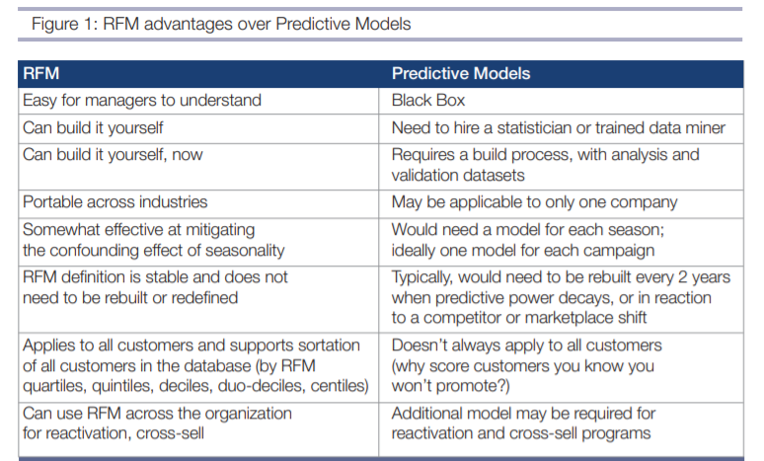
RFM vs Predictive Models

Slide 12
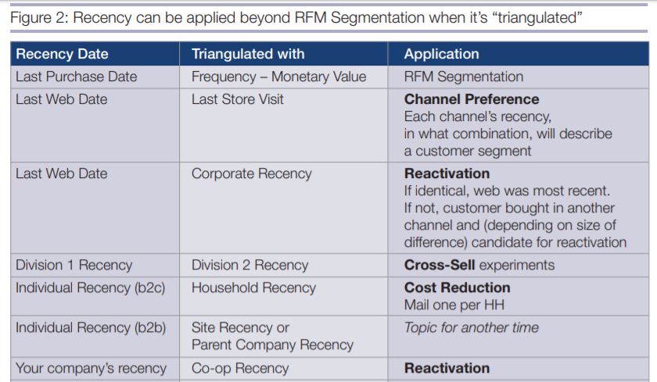

Slide 13
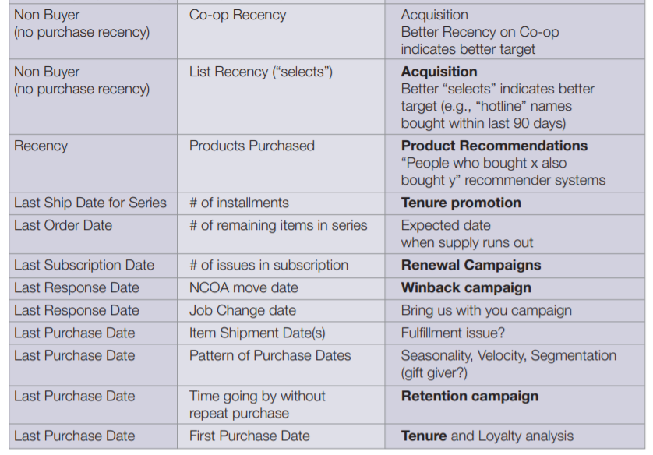

Slide 14
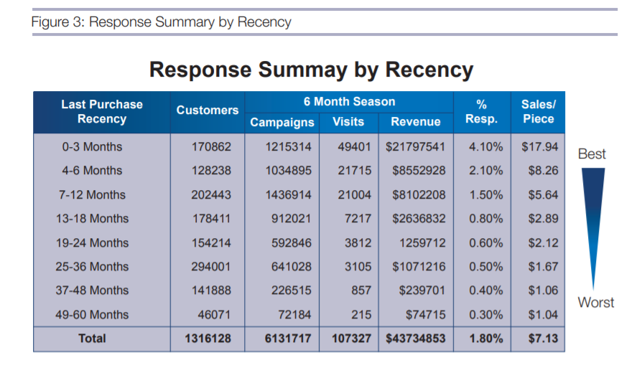

Slide 15
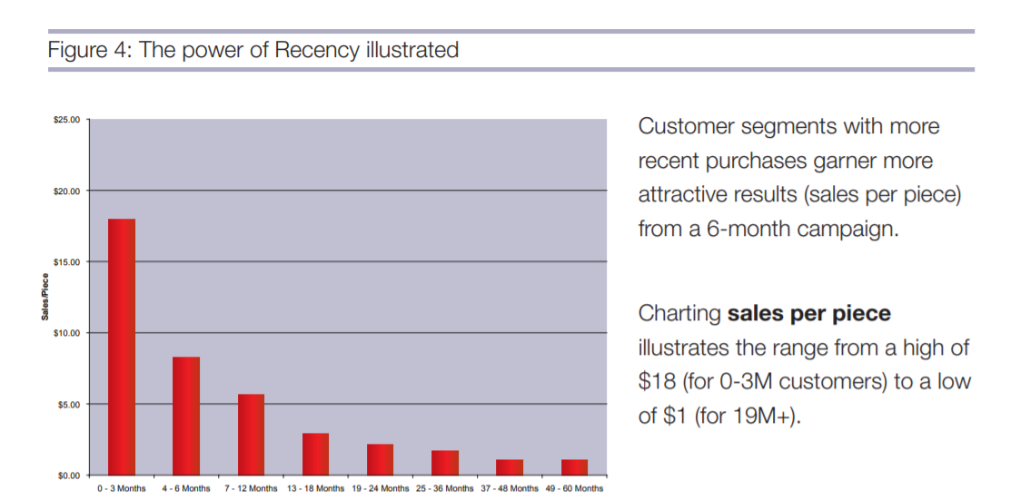

Slide 16
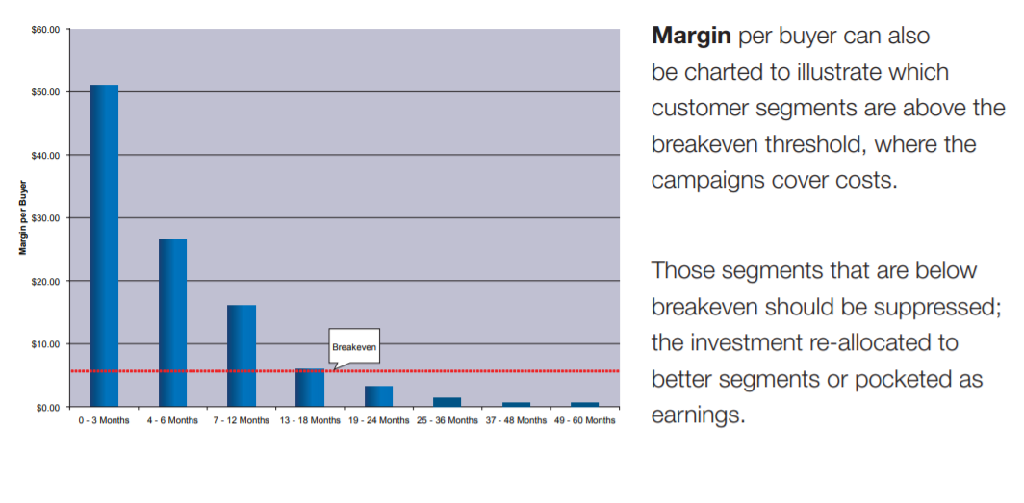

Slide 17
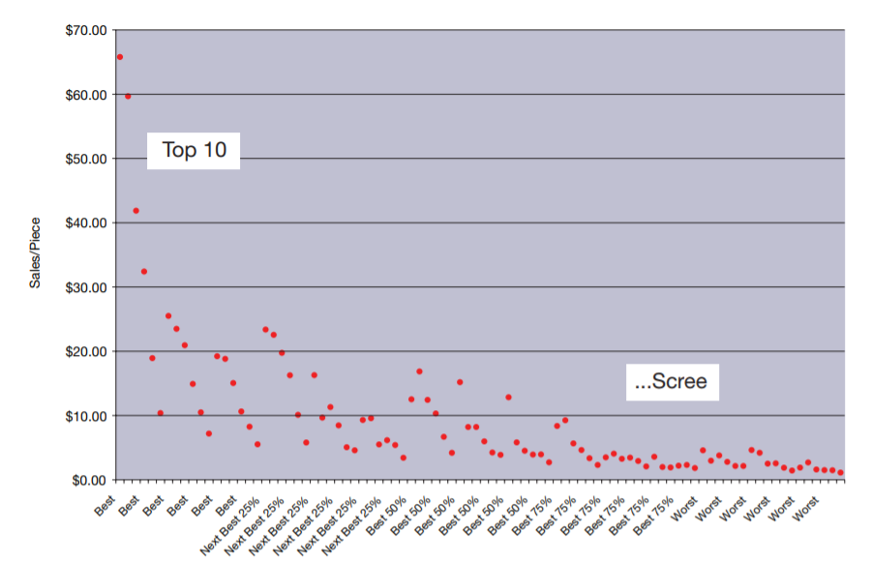

Slide 18
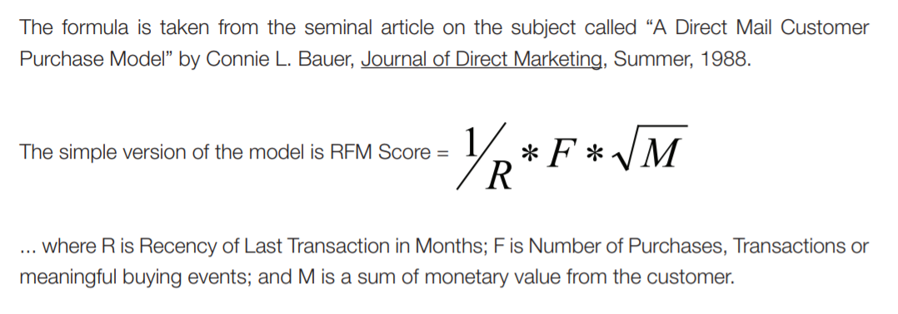
Alternative RFM Score

Slide 19
RFM Method 2- Regression Method
Regression techniques to compute the relative weights of the R, F, and M metrics
Relative weights are used to compute the cumulative points of each customer
The pre-computed weights for R, F and M, based on a test sample are used to assign RFM scores to each customer
The higher the computed score, the more profitable the customer is likely to be in the future
This method is flexible and can be tailored to each business situation

Slide 20
Recency Score
20 if within past 2 months; 10 if within past 4 months; 05 if within past
6 months; 03 if within past 9 months; 01 if within past 12 months;
Relative weight = 5
Customer
Purchases (Number)
Recency (Months)
Assigned Points
Weighted Points
1
2
20
100
JOHN
2
4
10
50
3
9
3
15
SMITH
1
6
5
25
1
2
20
100
MAGS
2
4
10
50
3
6
5
25
4
9
3
15

Slide 21
Frequency Score
Points for Frequency: 3 points for each purchase within 12 months; Maximum = 15 points; Relative weight = 2
Customer
Purchases(#)
Frequency
Assigned Points
Weighted Points
1
1
3
6
JOHN
2
1
3
6
3
1
3
6
SMITH
1
2
6
12
1
1
3
6
MAGS
2
1
3
6
3
2
6
12
4
1
3
6

Slide 22
Monetary Value Score
Monetary Value: 10 percent of the $ Volume of Purchase with 12 months; Maximum = 25 points; Relative weight = 3
Customer
Purchases (Number)
Monetary
Assigned Points
Weighted Points
1
$40
4
12
JOHN
2
$120
12
36
3
$60
6
18
SMITH
1
$400
25
75
1
$90
9
27
MAGS
2
$70
7
21
3
$80
8
24
4
$40
4
12

Slide 23
RFM Cumulative Score
Customer
Purchases (Number)
Total Weighted Points
Cumulative Points
1
118
118
JOHN
2
92
210
3
39
249
SMITH
1
112
112
1
133
133
MAGS
2
77
210
3
61
271
4
37
308
Cumulative scores: 249 for John, 112 for Smith and 308 for Mags; indicate a potential preference for Mags
John seems to be a good prospect, but mailing to Smith might be a misdirected marketing effort

Slide 24
Reference
https://cdn2.hubspot.net/hub/184373/file-41856256-pdf/docs/modern-approach-to-rfm-segmentation-ebook.pdf
http://web.nchu.edu.tw/~jodytsao/CRM/40471871-CRM-A-Database-Approach-Kumar-Reinartz-Ch06.ppt

Slide 25
THANK YOU

